Slide 1
Business Librarians in the Age of FinTech SOUCABL 2019 Dan Lê Business Librarian
Image ID#: 13742 By Amanda Mills/CDC-Public Domain-Available in the Public Health Image Library.

Slide 2
Overview
What is Fintech?
Trends in Fintech and Business Education
Georgia FinTech Academy
Library Resources
Image ID#: 13742 By Amanda Mills/CDC-Public Domain-Available in the Public Health Image Library.
Notes:
I’d like to start out this presentation with a disclaimer that I’m not an expert about FinTech but rather a business librarian who is interested and fascinated by the trends, technologies, and education opportunities in this sector of financial services.

Slide 3
How did FinTech come about?
Financial Services & Information Technology
Historically financial services funded technologies and incorporated them into their businesses – telegraph to transfer money in 1800s
Heavy investment in technologies from the financial sectors

Slide 4
Why the Buzz @ FinTech?
FinTech companies are non-bank financial services/ FinTech = “Non-bank financial companies industry” search term
Driven by Internet & smart phones, Gen Y, and new technologies
Financial Crisis – less jobs in banking, increased regulation, lack of jobs for new grads, loss trust in central banking
Notes:
New technologies: data management, cloud-based, bio-metric, AI, personalized digital services (Google, Amazon, FB, etc.), blockchain

Slide 5
What is FinTech?
Non-banking businesses using technology to change financial business services
Traditional financial services firms using technology to improve their competitive advantage

Slide 6
FinTech Applications
Cryptocurrencies
Account Aggregation
Payments
Online Lending
Wealth Management
ICOs

Slide 7
Fintech Curriculum
Job Opportunities
Experiential
Entrepreneurial
Interdisciplinary
Trends in Education

Slide 8
FinTech Job Opportunities
US - $11.8 Billion funding 2018
Asia FinTech funding to increase to $70 Billion in 2020
Georgia FinTech Industry – “Transaction Alley”
70% of US transactions
118 billion in transactions annually
6 of 10 payment firms
40,000 Georgians
$72 Billion annual revenue

Slide 9
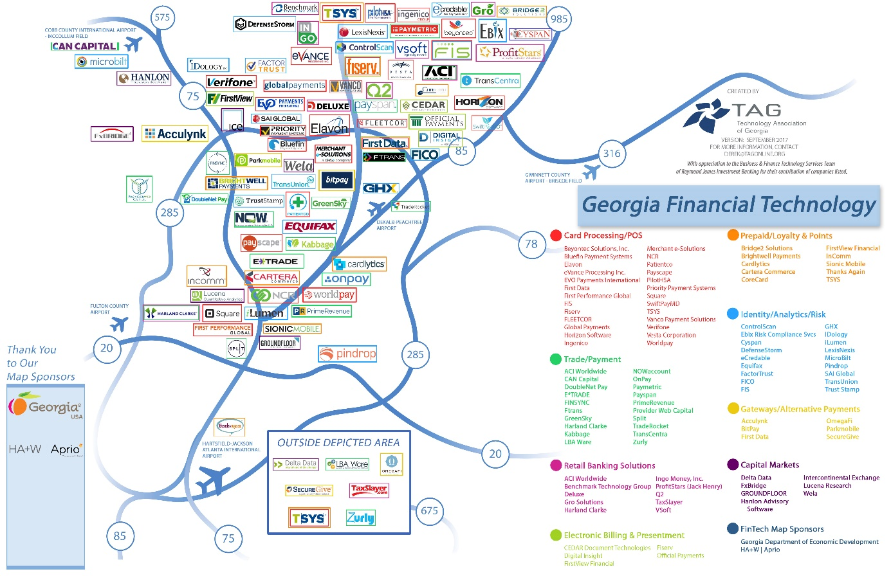
Georgia FinTech Map

Slide 10
Georgia FinTech Academy
Formed in 09/2018 by USG
5000 graduates in next 3 years
Open to students/professionals at 26 Georgia public institutions
Curriculum developed with FinTech employers
Virtual access through Augusta U’s Computer & Cyber Sciences
Physical locations at GSU Atlanta & Buckhead campuses
Nexus degree: 12 hrs upper-level, 6 hrs experiential, 42 hrs general

Slide 11
Library Resources
Providing same resources for all online students
Sharing research guides among Georgia FinTech Academy institutions
Promoting business resources including OER to faculty who develop online courses
Promoting consultation services to students with experiential courses
Creating workshops/space to support experiential learning
Ideas?

Slide 12
Sources Consulted
Blakstad, S., & Allen, R. (2018). FinTech revolution : Universal inclusion in the new financial ecosystem. Cham : Springer International Publishing : Imprint: Palgrave Macmillan.
FinTech – Georgia Department of Economic Development, http://workforce.georgia.gov/industries/fintech/
FinTech Law and Policy, Cousera, Duke University, https://www.coursera.org/
Fintech Sector Market Report. (2019). (). Melbourne: Acquisdata Pty Ltd. Georgia FinTech Academy, https://www.georgiafintechacademy.org/
Mary G. Fraser, Shari Buxbaum & Amy Blair (2002) The Library and the Development of Online Courses, Journal of Business & Finance Librarianship, 7:2-3, 47-59.
Rick Franza: FinTech Academy will break new ground in education, business partnerships, The Augusta Chronicle, https://bit.ly/2HEZlSd
Slavin, Laura C. “Library Services Online: Introducing Library Services for Online MBA Classes.” Journal of Library & Information Services In Distance Learning, vol. 9, no. 3, Jan. 2015, pp. 221–229.
University System of Georgia Announces Creation of Georgia FinTech Academy, University System of Geogia, Communications, https://bit.ly/2x4i9nO

Slide 13
FinTech in Library Survey
bit.ly/fintechlib

Slide 14
Thank you!
Dan Lê
Business Librarian
Georgia State University
Atlanta Library South-Suite 542
dle@gsu.edu //404-413-2808
bit.ly/fintechPPT

