Slide 1
Hope is Not a Strategy:
Making the Most of One-Shot Library Instruction for
Strategic Management Courses

Slide 2
A Bit About Me
Allison Cruse
Business Liaison Librarian
Western Carolina University - Cullowhee, NC

Slide 3
Background
The Course
MGT 404 - Strategic Management
Senior Capstone
The Assignment
Develop a full-scale strategic plan for an assigned local business
The Students
Diverse educational backgrounds
Limited library instruction/ interaction
Stressed out

Slide 4
What Did Not Work
Trying is the first step toward failure.
Homer J. Simpson

Slide 5
Things I Do Not Recommend
Trying to do it all
Talking theory
Placing the focus on the tools
Making assumptions

Slide 6
What Is Working
You miss 100% of the shots you don’t take.
- Wayne Gretzky
Michael Scott

Slide 7
Things To Try
Empower non-linear thinking
View the class as a marketing opportunity

Slide 8
Non-Linear Thinking
because A + B ≠ C

Slide 9
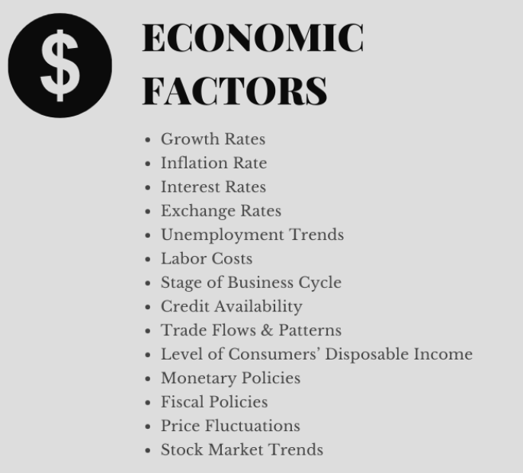
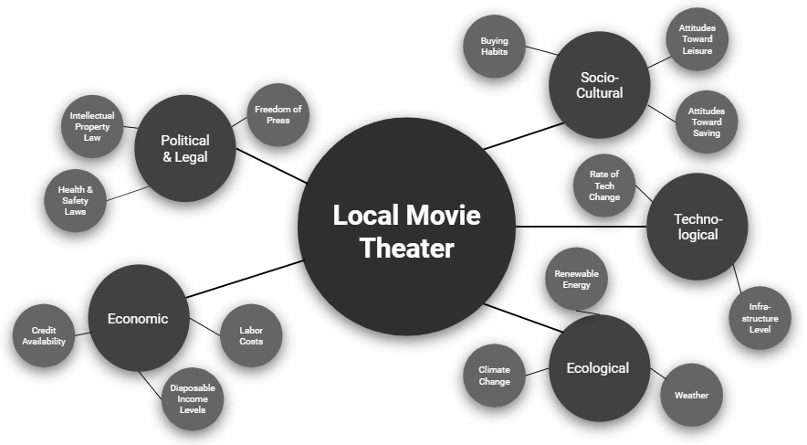
Brainstorming PESTE Factors Activity

Slide 10
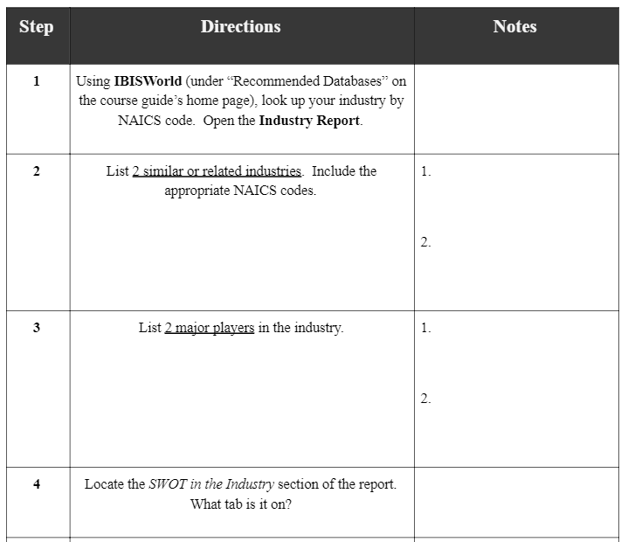
Dissecting IBISWorld Reports Activity

Slide 11
Marketing
Win and Retain Your Client Base

Slide 12
Marketing Library Services
Demonstrate value
Build relationships

Slide 13
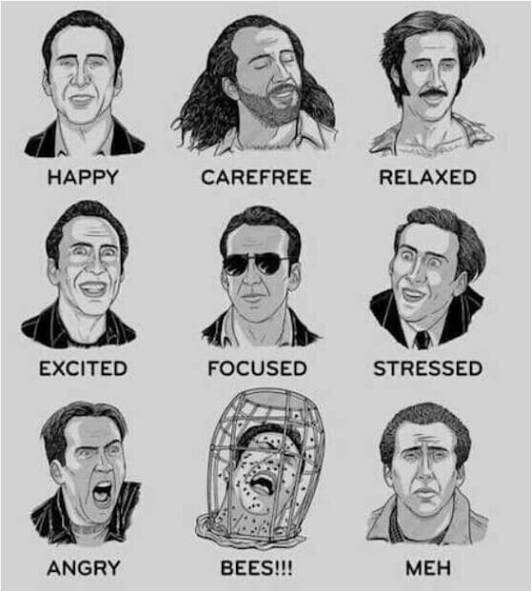
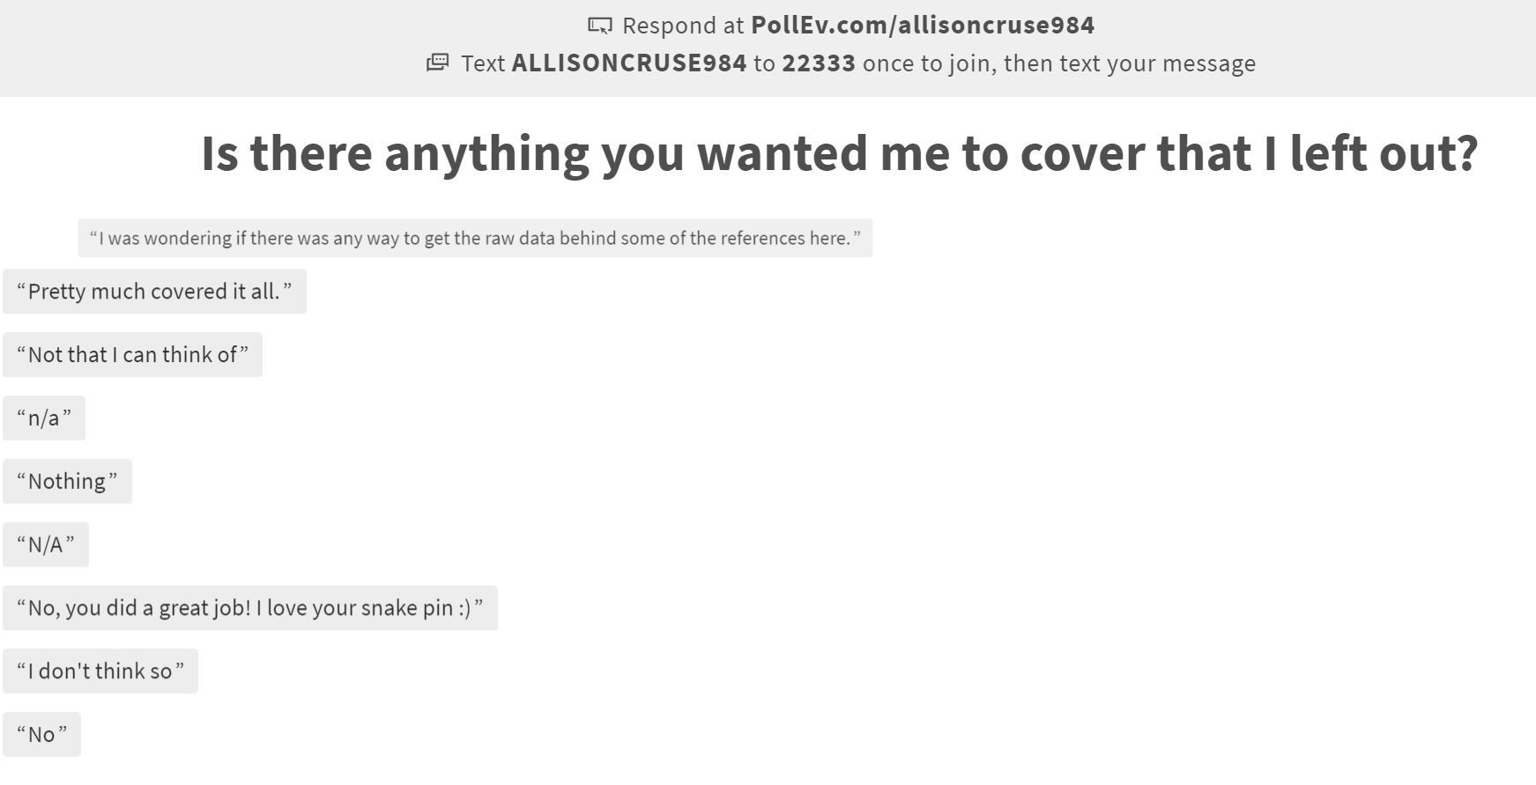
Assessment with PollEverywhere.com

Slide 14
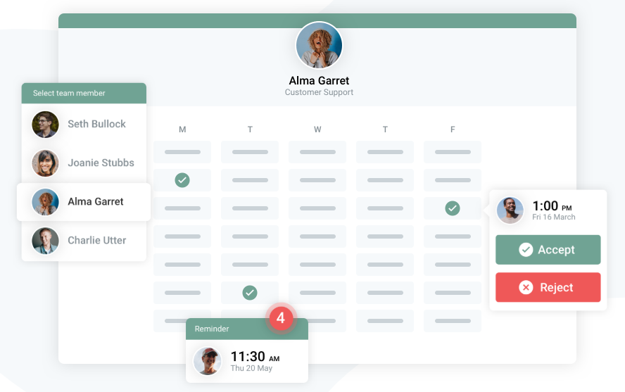
Online Booking with
YouCanBook.me

Slide 15
Planning for the Future
There’s nothing we can’t do if we work hard, never sleep, and shirk from all other responsibilities in our lives.
Leslie Knope

Slide 16
What’s Next?
Student-focused content strategy
Customized videos and infographics

Slide 17
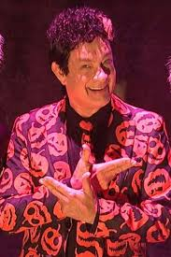
thanks!
Any questions?
You can find me at:
acruse@wcu.edu

Slide 18
You can also split your content
White
Is the color of milk and fresh snow, the color produced by the combination of all the colors of the visible spectrum.
Black
Is the color of coal, ebony, and of outer space. It is the darkest color, the result of the absence of or complete absorption of light.

Slide 19
Extra graphics

Slide 20
SlidesCarnival icons are editable shapes.
This means that you can:
Resize them without losing quality.
Change fill color and opacity.
Isn’t that nice? :)
Examples:

